Slide 1
PPP Loan Program Updates: What You Need to Know About the New Forgiveness Rules

Slide 2
What we’ll cover
Who is Pursuit and what is our relationship with SBA?
What is the Paycheck Protection Program (PPP) and how can my business benefit?
How will changes to the loan forgiveness aspect of the program benefit my business?
How do I apply for a PPP loan through Pursuit?

Slide 3
About us
Community-focused lender 100% invested in our borrowers’ success
65+ year history of offering innovative lending solutions to help business owners achieve their dreams
Provides a streamlined path to business funding—borrowers can directly access 15+ loan programs through a single lender

Slide 4
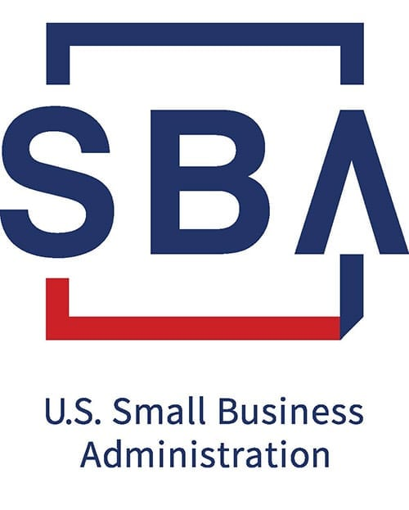
Pursuit and the Small Business Administration (SBA)
Notes:
Pursuit is a direct lender who provides small business financing and specializes in Small Business Administration (SBA) loans.
The SBA provides the rules and regulations for the Paycheck Protection Program which Pursuit must follow.
Pursuit will collect and submit all loan applications for approval and manage the loan forgiveness process based on instructions outlined by SBA. All communication regarding your loan should be made with Pursuit.

Slide 5
Pursuit’s advice to business owners
Do not panic! Be patient!
The rules around loan forgiveness have evolved over the past few weeks to benefit small business owners. Pay attention to updated guidance which may be beneficial.
There are no “experts” with more knowledge about PPP – be careful incurring additional expenses with third party “experts” who claim that they can assist in your forgiveness application.

Slide 6
What is the Paycheck Protection Program (PPP)?
SBA-facilitated forgivable loan
Amount = 2.5x your average monthly payroll
Applications accepted through 6/30
Notes:
Loan program facilitated by SBA to assist small businesses impacted by the coronavirus. The most significant benefit is that the entire loan can be forgiven if proceeds are used on eligible expenses, essentially turning this into a grant.
The loan amount is calculated based on two and a half times the average monthly payroll.
Applications will be accepted through June 30th.

Slide 7
Changes to the loan forgiveness regulations
On June 5th, the Paycheck Protection Program Flexibility Act was signed into law which provides businesses with more time and flexibility to obtain loan forgiveness on their PPP loan.
If you obtain a PPP loan through Pursuit, you will receive periodic updates to remind you to upload necessary documents throughout your forgiveness period. We will also keep you informed of any program updates or further guidance provided by SBA.

Slide 8
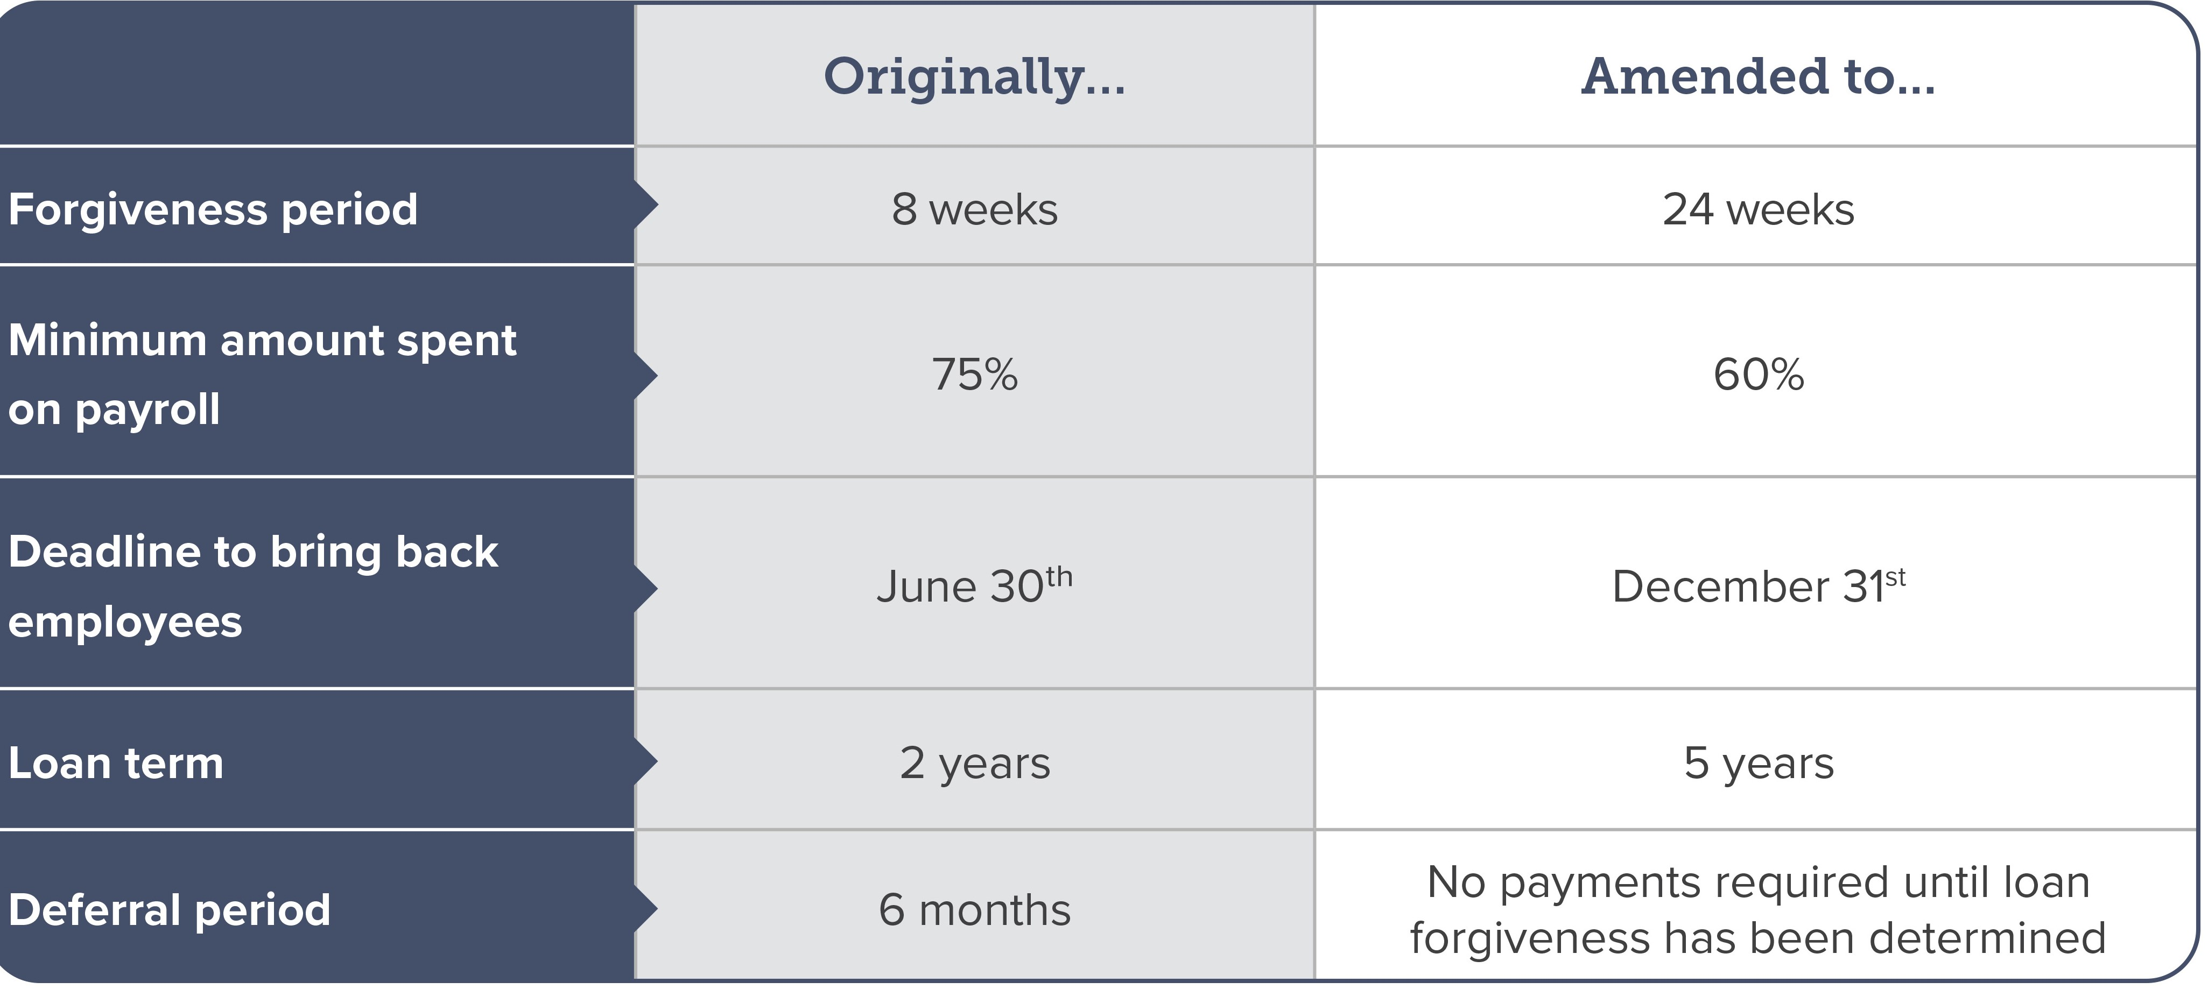
Key PPP changes
Notes:
More flexibility in loan forgiveness – 24 weeks
The covered period for loan forgiveness has been extended from eight weeks after the initial disbursement to 24 weeks after the initial disbursement.
More flexibility in loan forgiveness – 60% on payroll
The requirement that 75% of a borrower’s loan proceeds must be used for payroll costs and that 75% of the loan forgiveness amount must be spent on payroll costs during the covered period has been reduced to 60% for each of these requirements.
More flexibility in loan forgiveness – extended deadline
Businesses were previously required to have the same number of full-time equivalent employees by June 30th or they would be subjected to a mandated reduction in loan forgiveness. That deadline has now been extended to December 31st providing more flexibility.
There are also helpful stipulations for businesses unable to reopen due to compliance with requirements of Health and Human Services, Centers for Disease Control and Prevention, or Occupational Safety and Health Administration.
More flexibility in loan forgiveness – five-year maturity
The maturity of PPP loans has increased to five years compared to the previous maturity of two years. If the loan is not forgiven, businesses will have an extended time period to repay the balance of the loan.
The deferral period for borrower payments has also been extended so if a business obtains loan forgiveness, they will not make any payments until the forgiveness application is complete.

Slide 9
These changes make it possible to rethink PPP

Slide 10
Pursuit’s goals for loan forgiveness
We will proceed cautiously to maximize the forgiveness and minimize the level of difficulty in obtaining this forgiveness.
We will provide updated guidance and information as it becomes available from SBA to ensure you can maximize your loan forgiveness.
We will attempt to make the forgiveness process application and process as painless as possible so you can focus on running your business.

Slide 11
Apply for a PPP loan today!
www.pursuitlending.com/pppapply
Notes:
-Apply in 20 minutes through an easy to use digital portal
-We’re currently quickly approving loans in 1-2 days

